Slide 1
WhatsApp Chat
ANALYZER
UNDER THE GUIDANCE OF
PROF. GANESHKUMAR R. NARAYANKAR
PRESENTED BY :
VIVEK MOHANLAL MAURYA

Slide 2
01 Introduction
02 Proposed System
03 Advantages&Disadva
04 Function
05 Flow Chart&Class
06 Screenshots
07 Conclusion
08 Future Enhancement
09 Reference
CONTENTS

Slide 3
INTRODUCTION
The most used and efficient method of communication in recent times is an application called WhatsApp. WhatsApp chats consist of various kinds of conversations held among groups of people. This chat consists of various topics. This information can provide lots of data for the latest technologies such as machine learning. The most important thing for a machine learning model is to provide the right learning experience which is indirectly affected by the data that we provide to the model.
Our Project WhatsApp Chat Analyser aims to provide in-depth analysis of this data which is provided by WhatsApp.

Slide 4
PROPOSED SYSTEM:
The WhatsApp Chat Analyser is designed for any user who wants to get an in-depth analysis of their whatsapp chats. The new system is easy to use, helps you to analyse personal as well as group chats in an efficient manner. These services are to be provided in an efficient, cost effective manner, with the goal of reducing the time and resources currently required for such tasks.

Slide 5
ADVANTAGES&DISADVANTAGES
ADVANTAGES:
Understanding communication patterns
Identifying key contributors
Evaluating sentiment
Tracking trends
Time-Saving
DISADVANTAGES:
Raw Data Format
Individual Chat Exports
Privacy concerns
Limited context

Slide 6
FUNCTION:
FUNCTION:
Data Import and Preparation
Message Statistics
Sentiment Analysis
Keyword and Topic Analysis
Comparative Analysis
WordCloud
Activity Map
Messaging Frequency

Slide 7
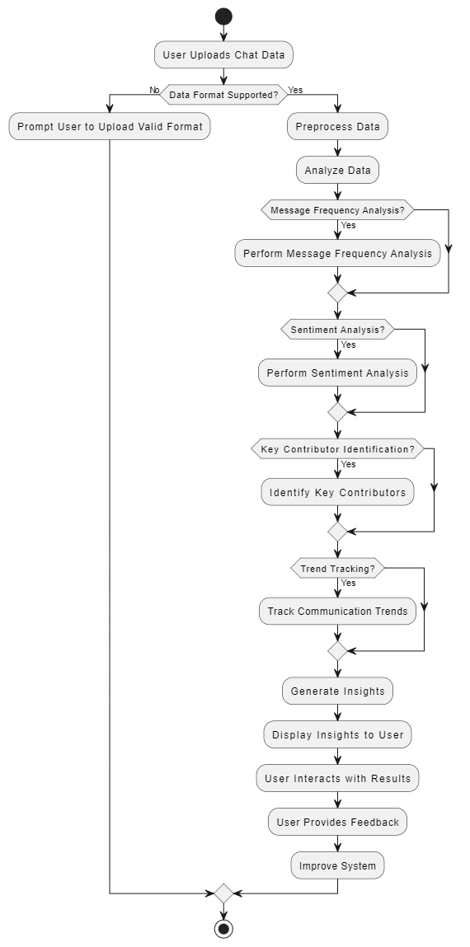
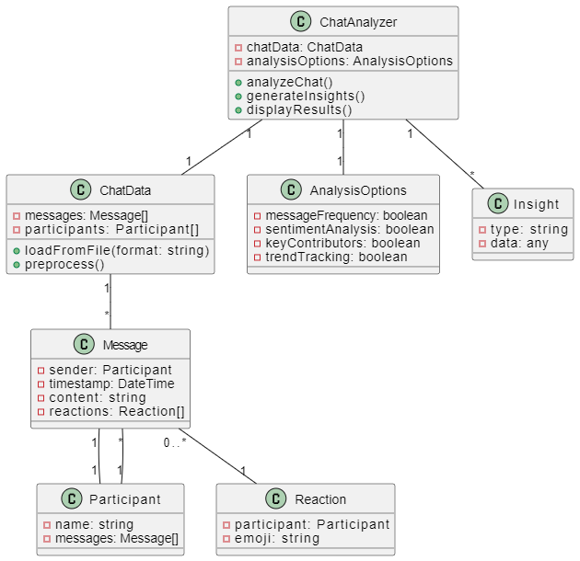
Flow Chart & Class Diagram:

Slide 8
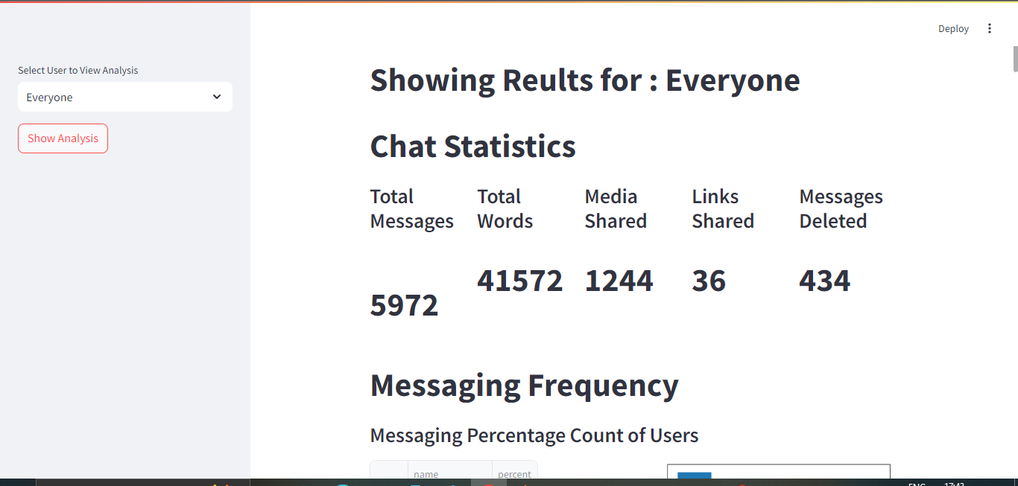
SCREENSHOTS

Slide 9
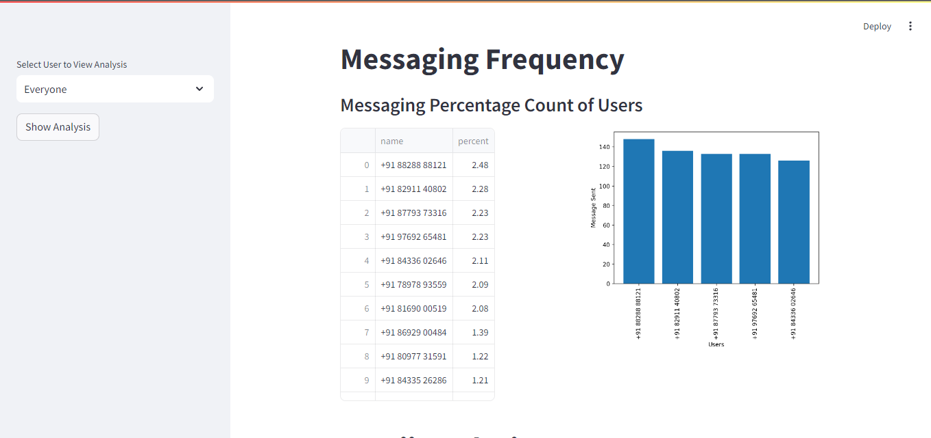

Slide 10
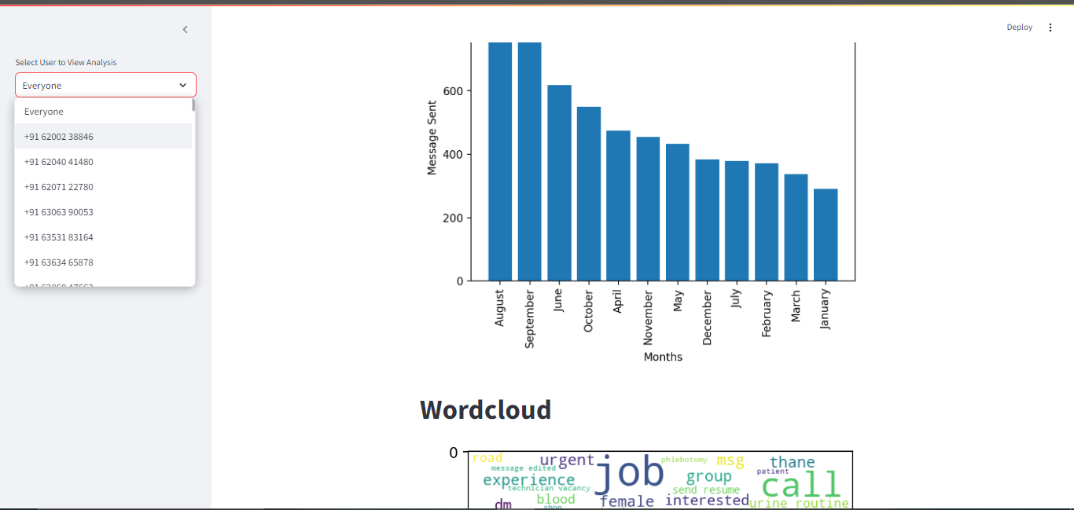

Slide 11
CONCLUSION:
This work was able to discuss the WhatsApp application and its libraries, to create an analysis of a WhatsApp group chat and visually represent the top 10 and top 20 users in the chat groups. A pseudocode of the plot was given and at the end, visual representation of the plot was implemented. Also, an analysis of the top 10 and top 20 users were done. The system was done with python, and the python libraries that were implemented includes, NumPy, Pandas, Matplotlib and Seaborn.

Slide 12
FUTURE ENHANCEMENT:
Sentiment Analysis: Assess the emotional tone of messages.
User Engagement Metrics: Identify active participants and response times.
Privacy Features: Ensure data anonymization and user control.
Cross-Platform Integration: Analyze chats from multiple messaging apps.
Language Support: Include multi-language analysis capabilities.
Archive and Export Options: Allow data saving in various formats.

Slide 13
REFERENCE AND BIBLIOGRAPHY:
BOOKS:
Python for Data Analysis
Natural Language Processing with Python
VIDEOS:
Streamlit Tutorial for Beginners
https://www.youtube.com/playlist?list=PLuU3eVwK0I9PT48ZBYAHdKPFazhXg76h5
Data Visualization and Matplotlib
https://www.youtube.com/watch?v=9GvnrQv138s&list=PLjVLYmrlmjGcC0B_FP3bkJ-JIPkV5GuZR
WEB PAGES:
https://streamlit.io/
https://numpy.org/doc

Slide 14
THANK YOU

